Slide 1



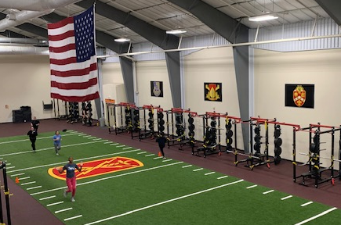
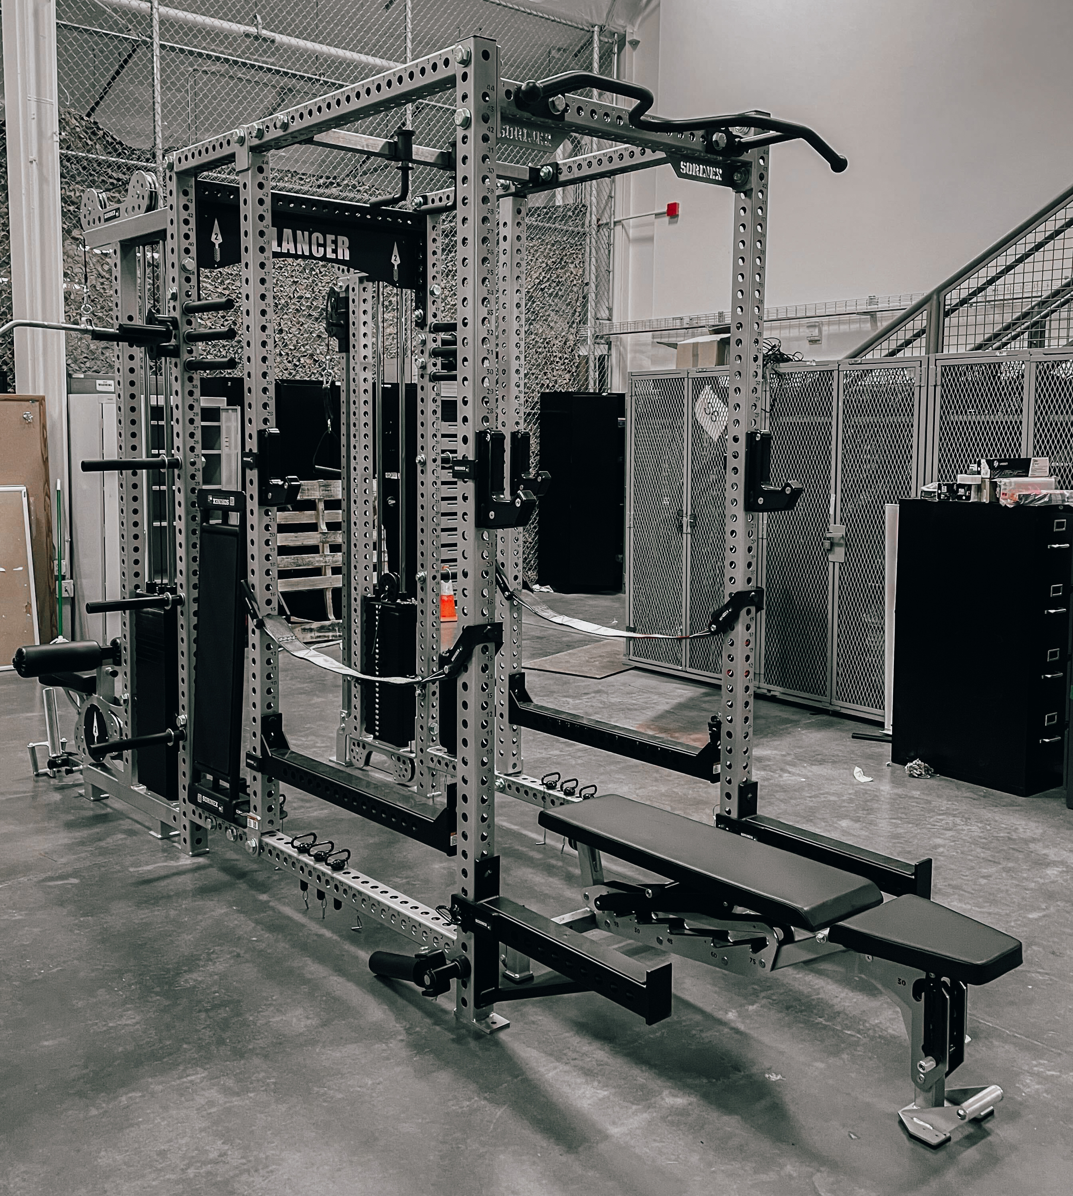
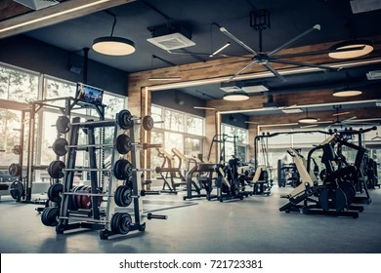
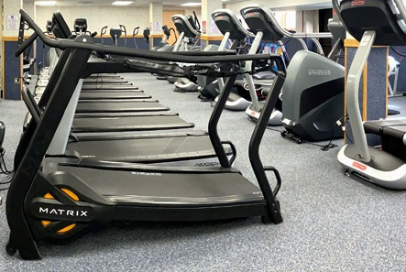
DLA Troop Support
Holistic Health and Fitness (H2F)
DLA Troop Support’s H2F program is managed by the Construction & Equipment Supply Chain. The H2F Program is designed for customers to order commercial off-the-shelf equipment related to overall Health and Fitness.
Examples of supported items:
Treadmills
Exercise Bikes
Turf Field
Gym Flooring
Ice Baths
Saunas
Total Body Trainer
Leg Press
Rowers
(Not an all-inclusive list)
Program Benefits
Commercial off-the-shelf products
Ability to add customization/logo on products
Customer direct delivery
Prime Vendor support
Dedicated TVLS
Each request is reviewed for scope
Funding: MIPR, MILSTRIP, & 7600B accepted
Email: TrpSpt_H2Fitness@dla.mil to get started or request more information
C&E Programs

